Slide 1
Lightning Talk
By: Andrew Peters, John Smolinski, James Eenhuis, Geng Sun, and Dheepak Nalluri

Slide 2
Product overview
A multi point map route maker.
Route can be time constrained and calculated.
Overview of available places nearby for viewing.

Slide 3
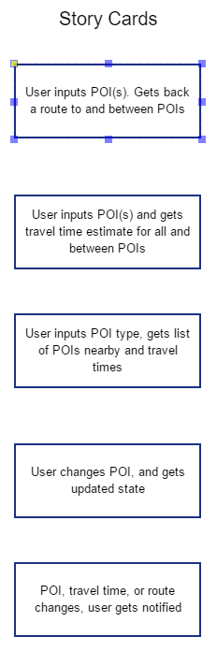
User Stories
Spoke with client about desires
Extracted stories from desires
Developed diagram from stories

Slide 4
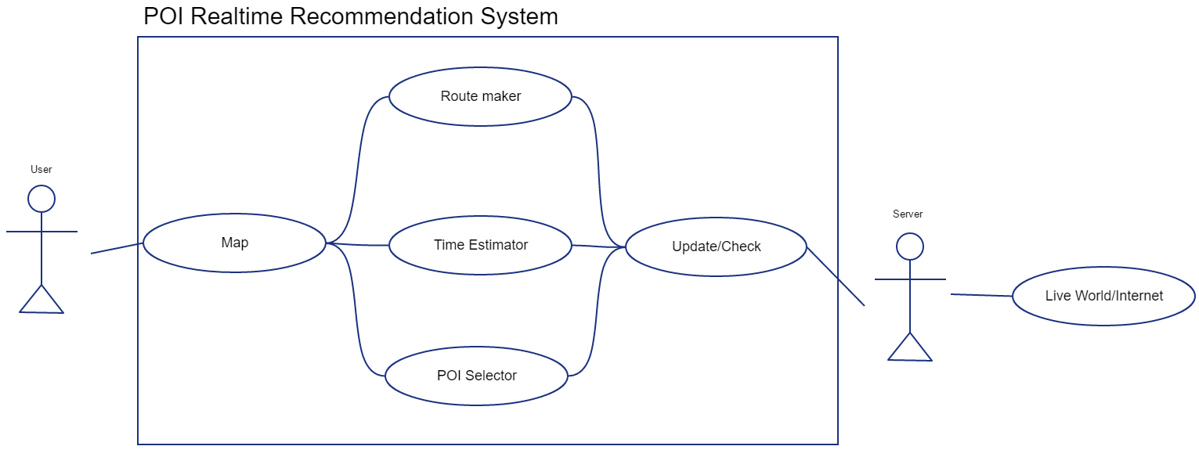
Use Case Diagram

Slide 5
Reactive vs machine learning
Choice between a reactive system and machine recommendation.
Research into machine cost and benefits must be carried out.

Slide 6
Timeline
Design document version 1 and team website version 1 done
Final design document done and final team web done
Integration testing for the system
Oct 3 2019
Dec 3 2019
April 2020
Oct 31, 2019
Jan 2020
May 2020
Design document version 2 done
Prototyping for individual systems and beta UI design system
Complete final documentation, bug fixing and testing

